Slide 1

Data Visualization
Stories will be found, Stories will be told

Slide 2
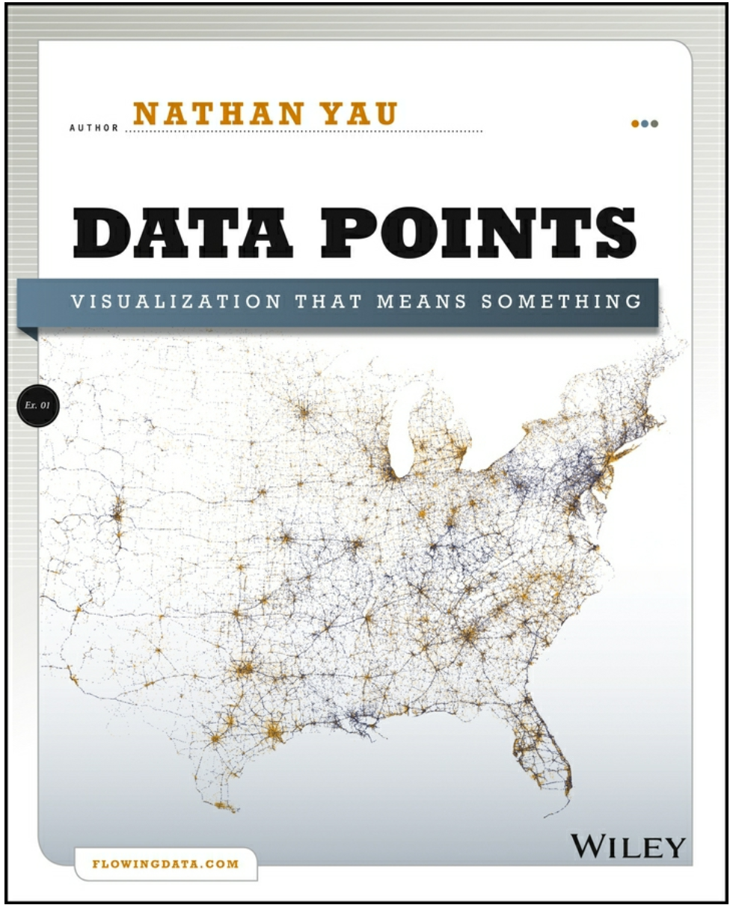
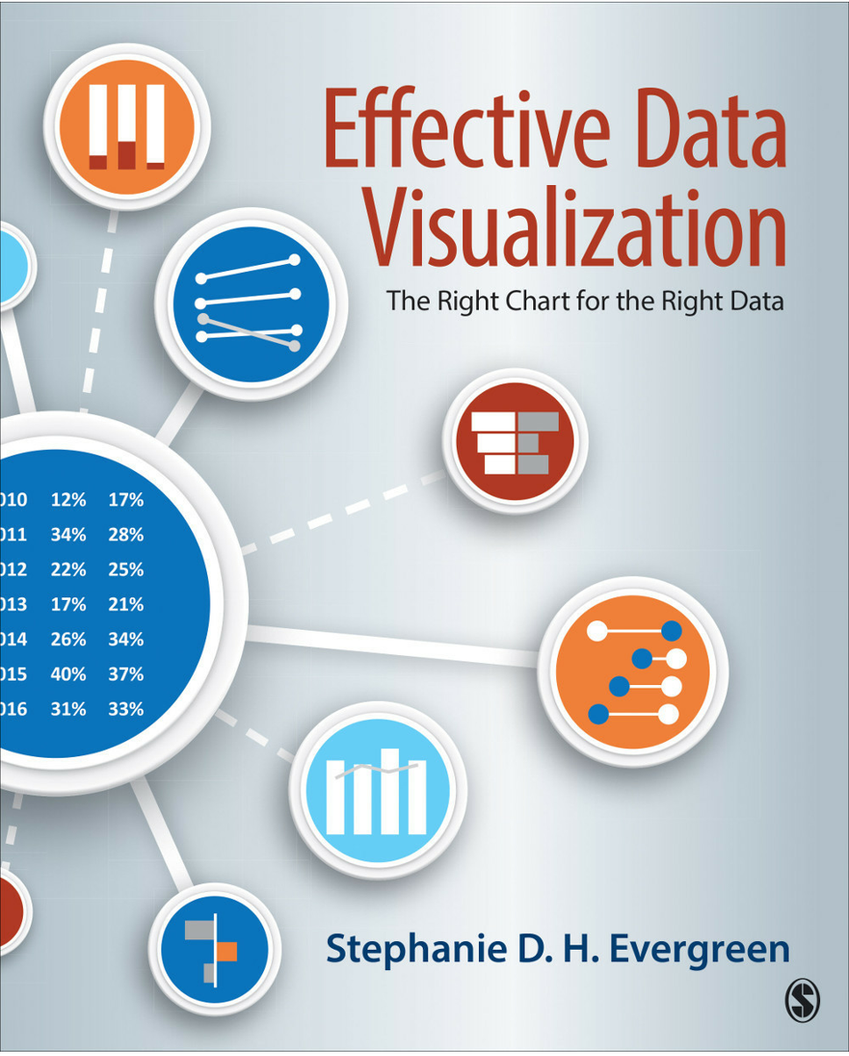
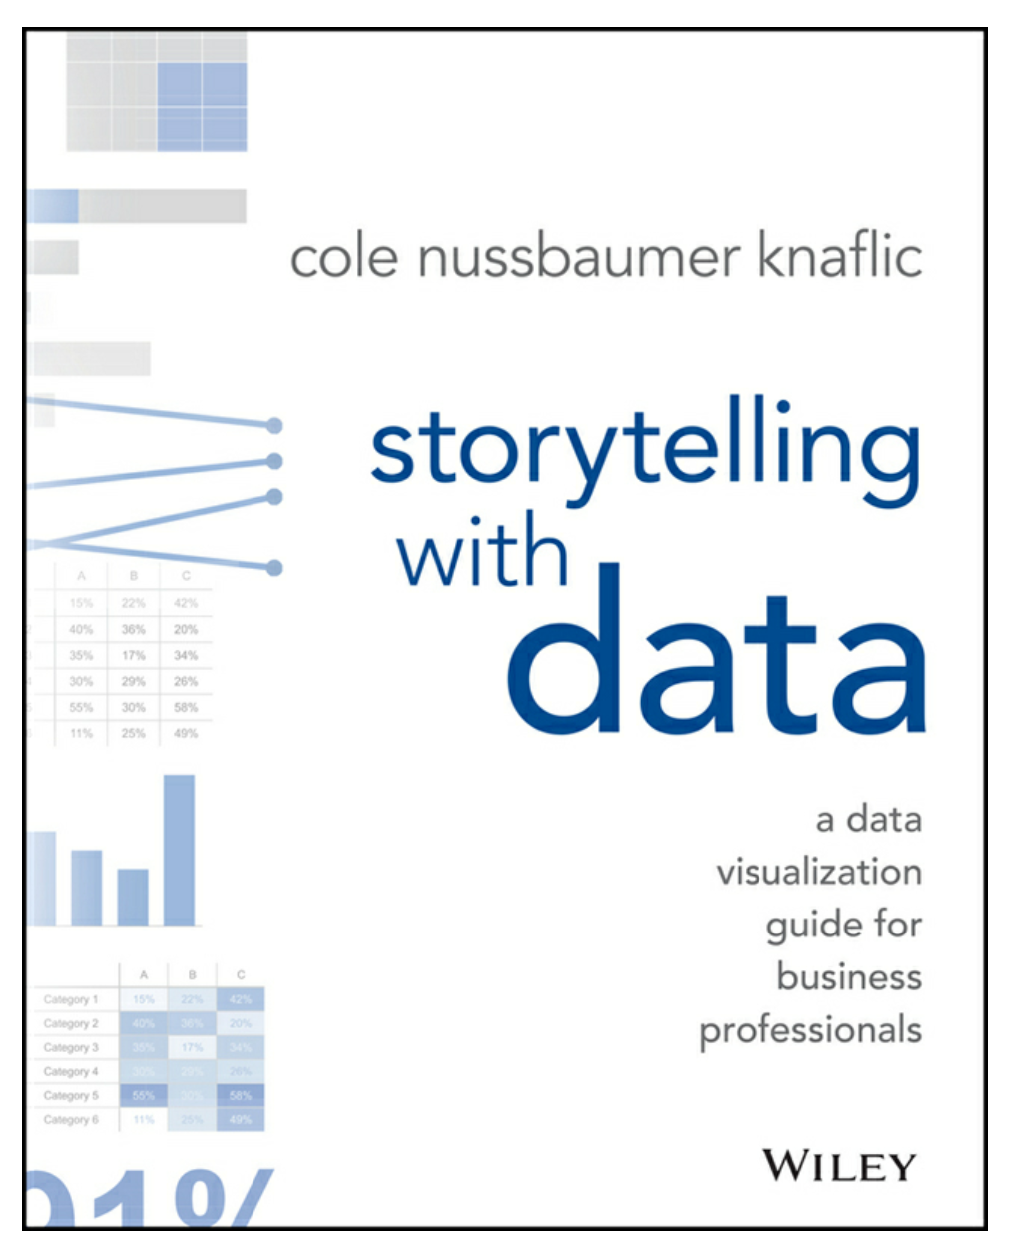

Slide 3
Why is Data Visualization Important?
I wonder if this sentence can be considered data, and you’d like to avoid reading every word, so you’ll skim to get the main point of the story. Is simple text highlighting really considered a visualization? We’ll talk about that later.
Effective Data Visualization
We are primarily visual and we skim for the main point
Data Points
Visualization helps you make sense of data, finding trends patterns, and outliers
Storytelling with Data
There is a story in your data and your tool doesn’t know how to tell it.

Slide 4
We visualize for two different reasons
Finding Stories (Exploratory)
Telling Stories (Explanatory)
DIFFERENT VIEWPOINTS
SINGLE VIEWPOINT
HOW DATA IS ORGANIZED
HOW TO ORGANIZE DATA
ASK LOTS OF QUESTIONS
SUGGEST AN ACTION

Slide 5


We visualize for two different reasons
Finding Stories (Exploratory)
Telling Stories (Explanatory)
Notes:
We start with Exploratory Visualization and end with Explanatory. It’s important to realize when you’re story finding and when you’re story telling

Slide 6

Fatal Crashes, 2001 - 2010
Simple doesn’t mean story
Notes:
This is very simple to understand. There were 363,839 fatal car crashes between 2001 - 2010.
What’s the problem? Why isn’t this a story? We don’t know what to do with this info. There are still lots of questions.
In what location. Why did they happen. If our story is too simple and doesn’t suggest anything, our audience immediately tries to find the story for us. We don’t want our audience to start doing story finding once they see our graph.

Slide 7
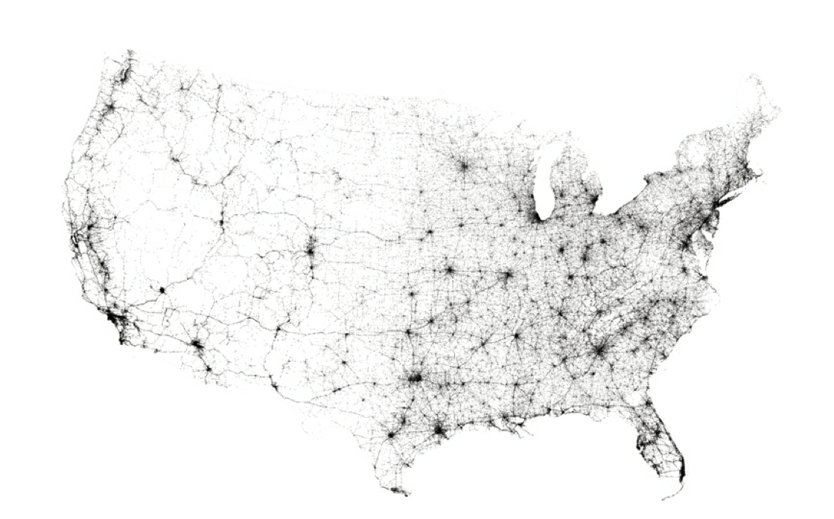
Exploratory Visualization
Story Finding
What do you notice?
Car crashes in the US 2001 - 2010
Hard to confirm without the visualization
How you generate
& test hypotheses about data
Does this visualization
telI a story?
Notes:
It’s important to have an interesting story. That’s one of the big parts of data visualization. Visualizing the data from different angles helps us find stories, generate and test hypotheses.
What do you notice about the data now? The east coast tends to have more car crashes overall. Is it because of snow?

Slide 8

Exploratory Visualization
Story Finding
Path of fireflies throughout the forest
Makes for great Aha! moments.
Hard to hypothesize without the visualization
Does this visualization
telI a story?
Notes:
It’s important to have an interesting story. That’s one of the big parts of data visualization. Visualizing the data from different angles helps us find stories, generate and test hypotheses.
What do you notice about the data now? The east coast tends to have more car crashes overall. Is it because of snow?

Slide 9

How do we go from Story Finding to Story Telling
Finding Stories (Exploratory)
Telling Stories (Explanatory)
Notes:
We start with Exploratory Visualization and end with Explanatory. It’s important to realize when you’re story finding and when you’re story telling

Slide 10
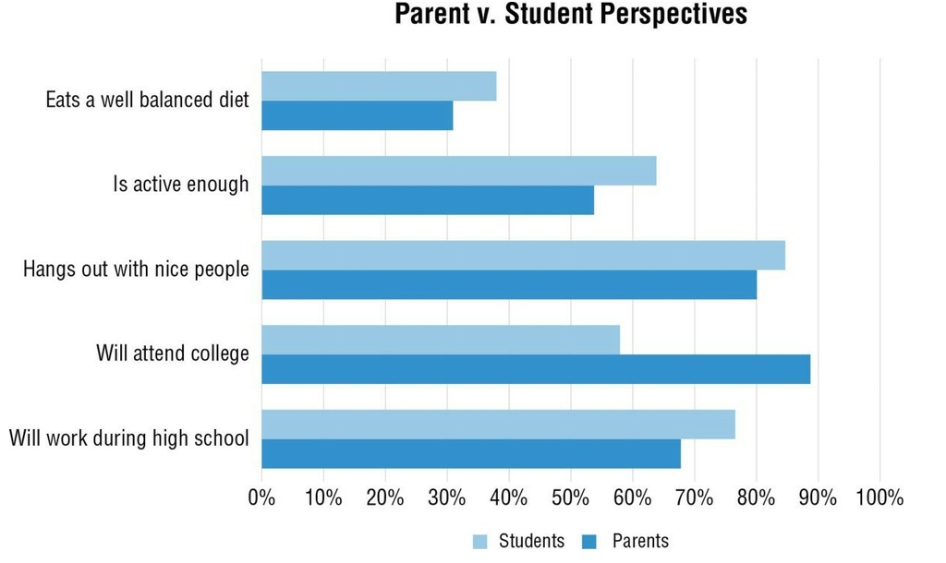
Before & After
What’s the point
What stories do you see?

Slide 11
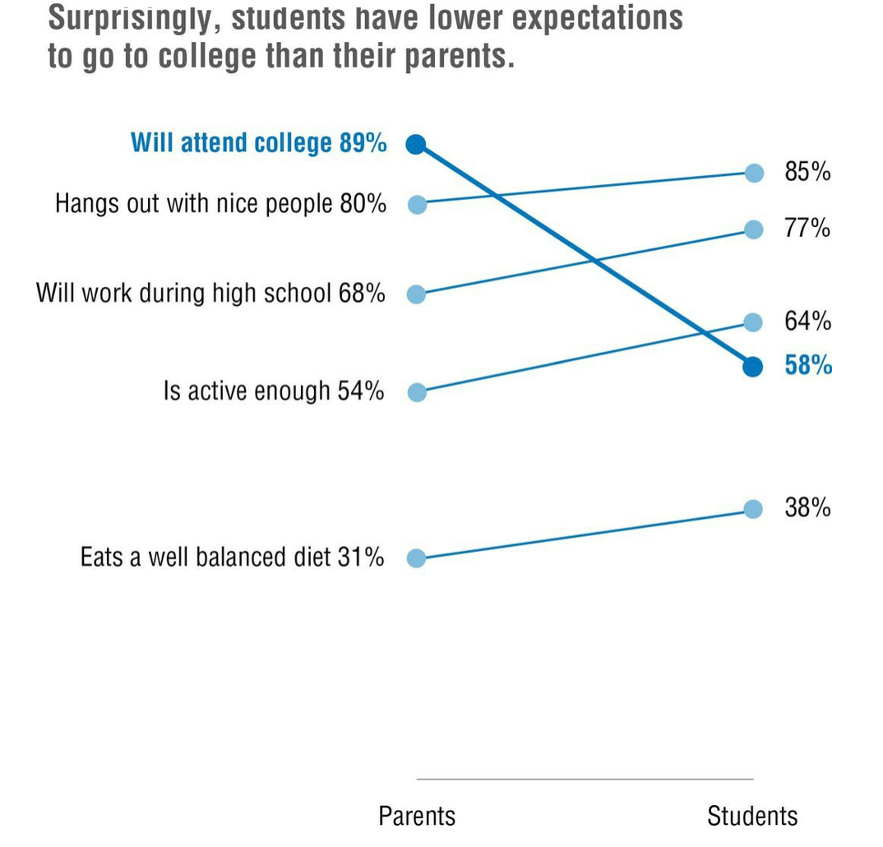
Before & After
What’s the point
What story are you drawn to first?

Slide 12

Before & After Revision II
What’s the point?
Story heard different than intended story told
Notes:
Can be a very iterative process. Figure out the point.

Slide 13






The Storytelling Process
In short
Get context
Choose an effective visual
Remove clutter
Focus your audience’s attention
Take advantage of design principles
Learn from other good examples
CONTEXT
EXAMPLES
VISUAL
DESIGN
CLUTTER
FOCUS
Notes:
We’ve talked about Story Finding, how cool it is, and the difference between telling and finding. Let’s dive into story telling.
Make these into verbs

Slide 14
The Importance of Context
The Storytelling Process
Who: Audience
What: Suggest an action or follow-up response
How: Prove your point with data
3-min story: one sentence story for visualizations
Notes:
Note: suggesting an action we want to be bold enough to actually suggest something.
You’re the expert.
A one sentence story will actually go in visualization header

Slide 15
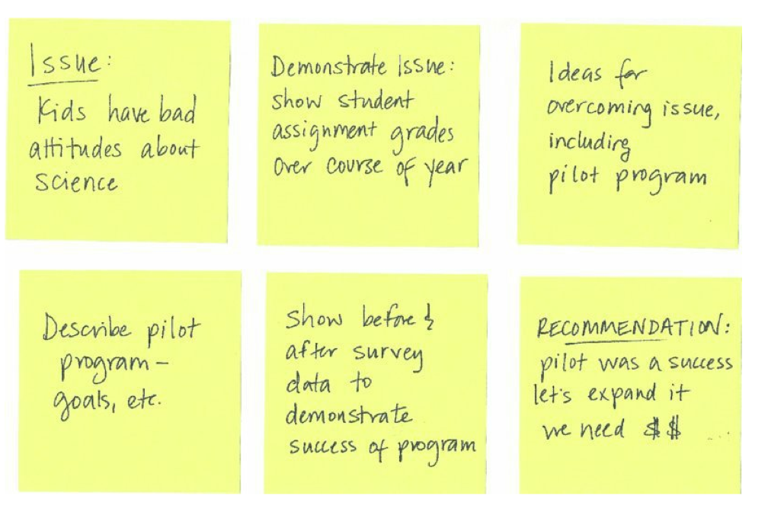
The Importance of Context
A storyboarding example
Storyboarding can help formulate the story you want to tell
After School Science Program

Slide 16
Choosing an Effective Visual
Stories for different scenarios
Single number
Visualizing Comparisons
Relative Performance
Survey Results
Parts of a Whole
Correlation & Regression
Qualitative Data
Depicting Trends
Notes:
We’ve talked about Story Finding, how cool it is, and the difference between telling and finding. Let’s dive into story telling.

Slide 17

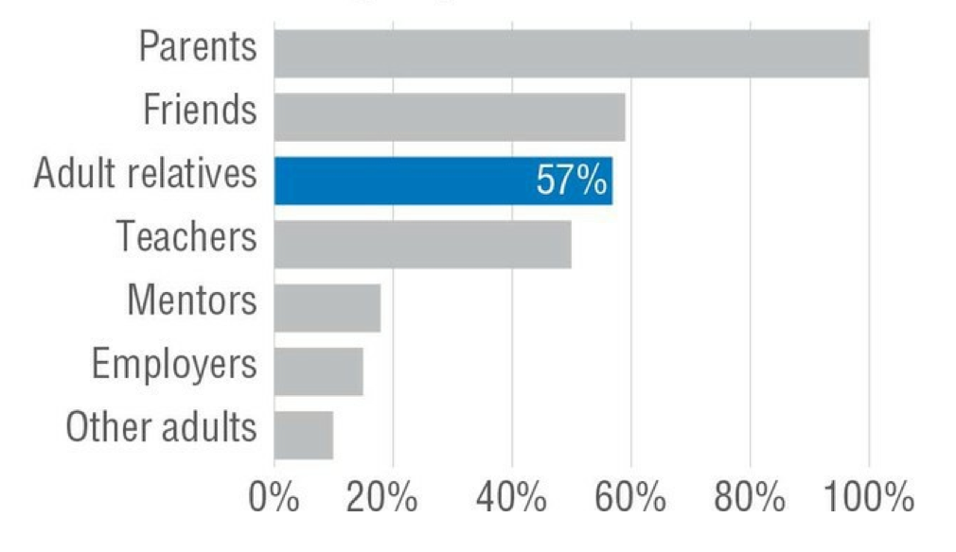
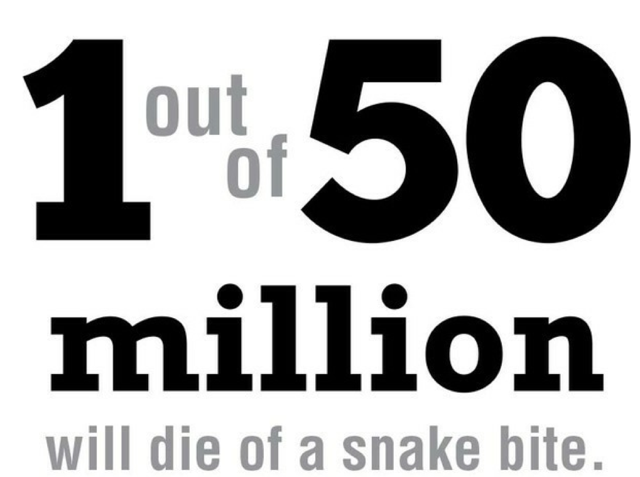
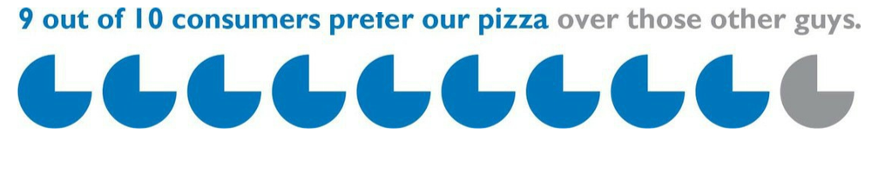
Choosing an Effective Visual
When a Single Number is Important
Story: To help remember one important number.
Other adapted options
Single Highlight Bar Chart
Big Number
Watch out for overdoing it
Icon Array
Notes:
We’ve talked about Story Finding, how cool it is, and the difference between telling and finding. Let’s dive into storytelling.

Slide 18
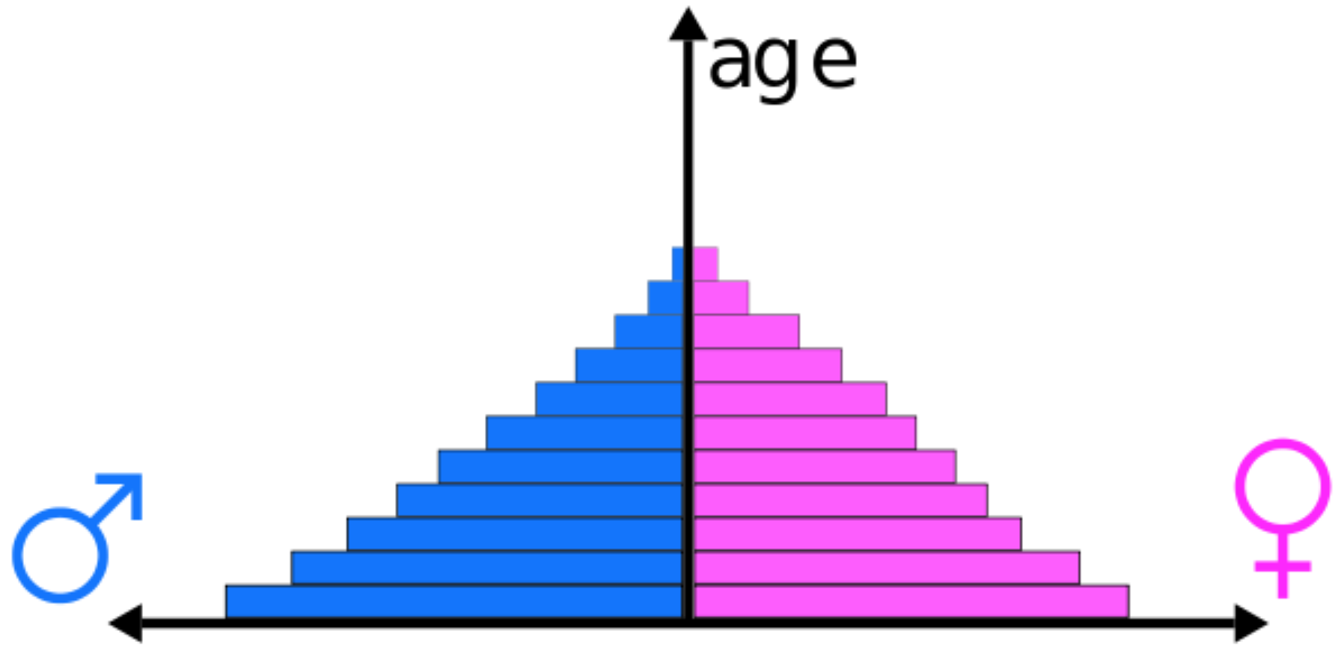
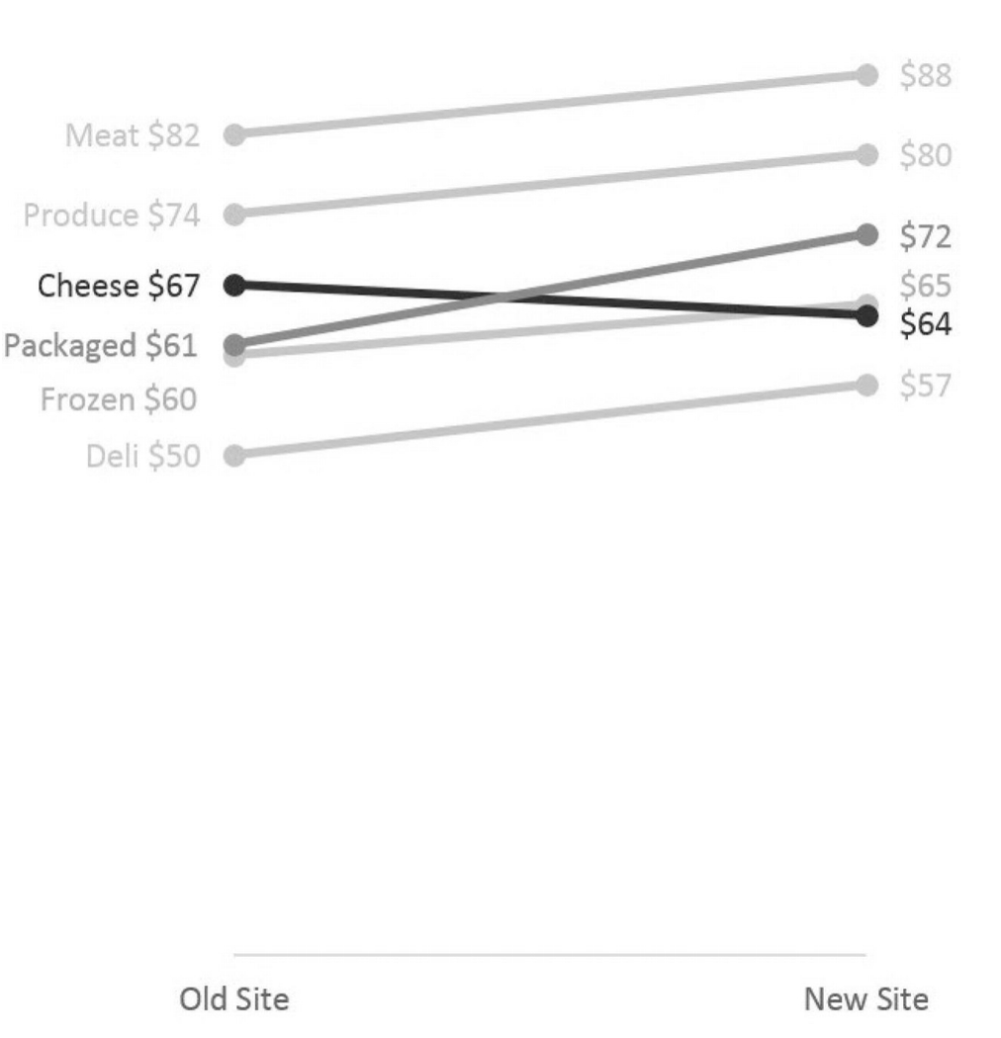
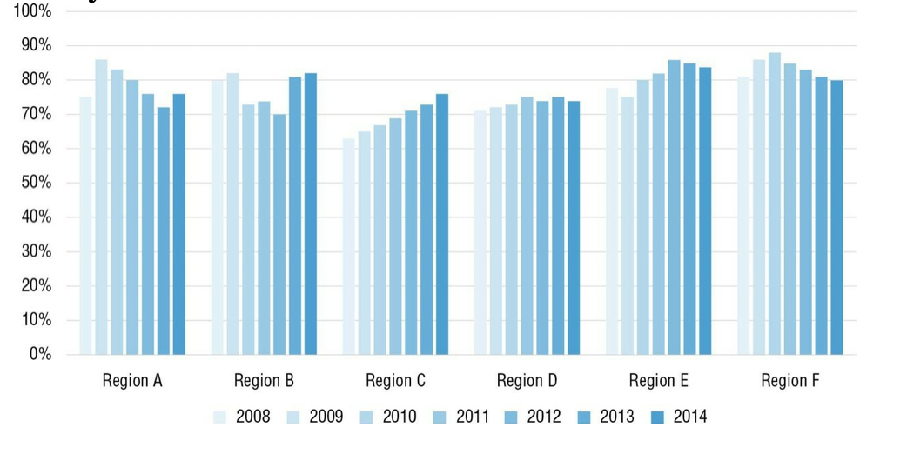

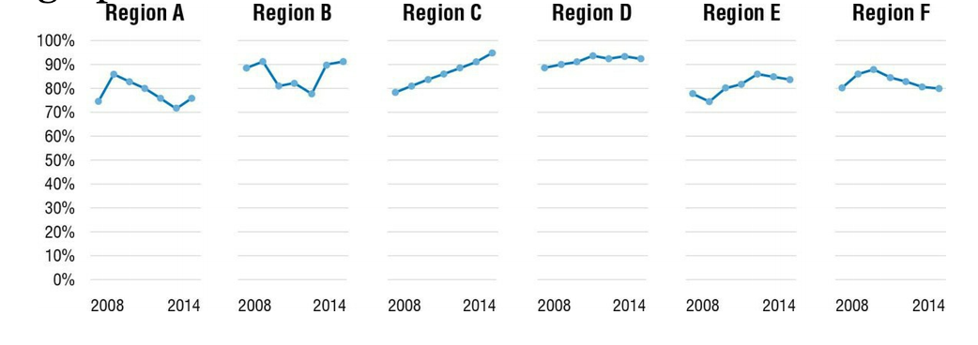
Choosing an Effective Visual
Visualizing Comparisons
Story: (Most common). To help users understand that one thing is better or worse.
Other Comparison visualizations
Humans are good at
comparing two lengths
judging slope
Population Pyramids
Small Multiples
Dot Plots
Dumbbell Dot Plots
etc...
Humans struggle with
length of many bars
length of non-adjacent bars
Bar Chart
Slope Graph
Notes:
We’ve talked about Story Finding, how cool it is, and the difference between telling and finding. Let’s dive into story telling.

Slide 19
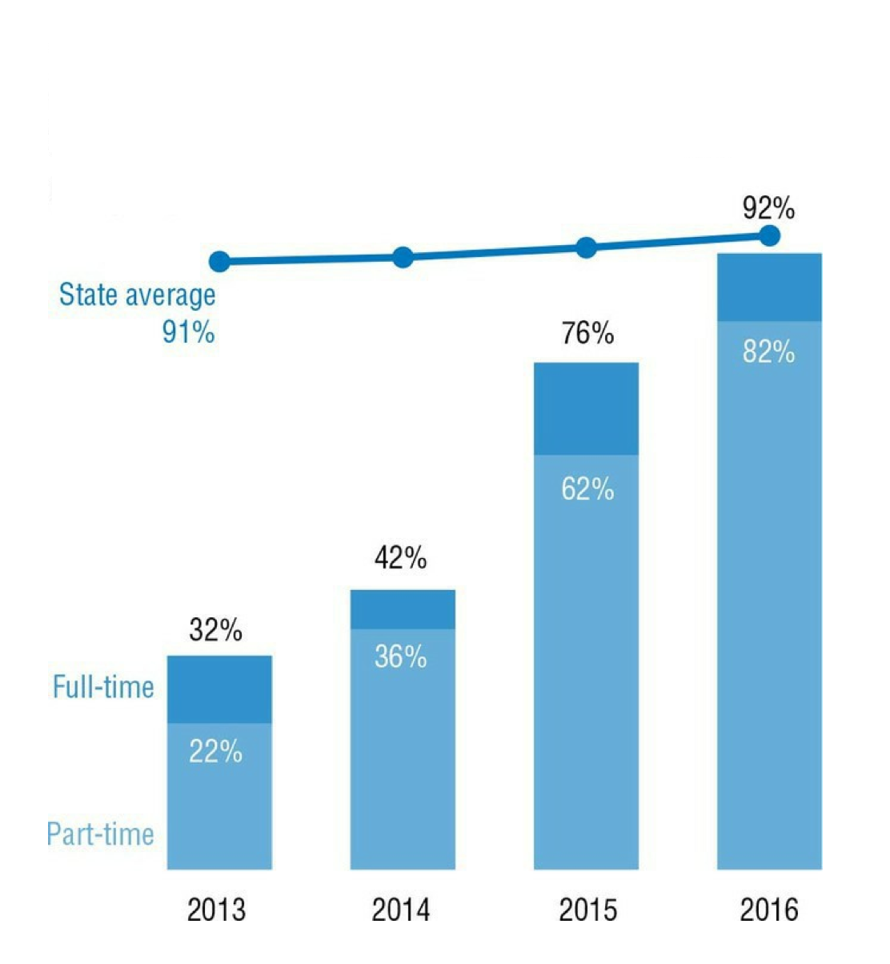
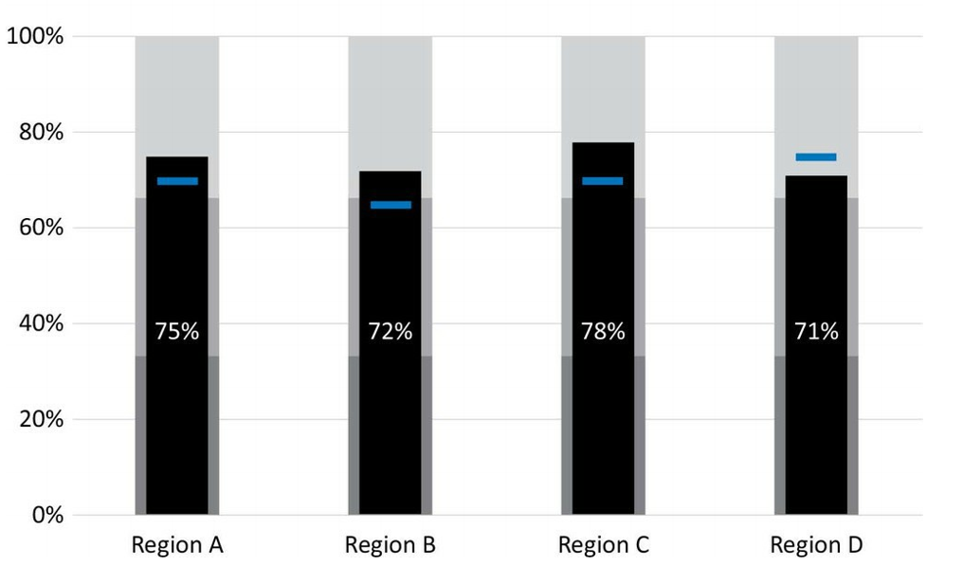
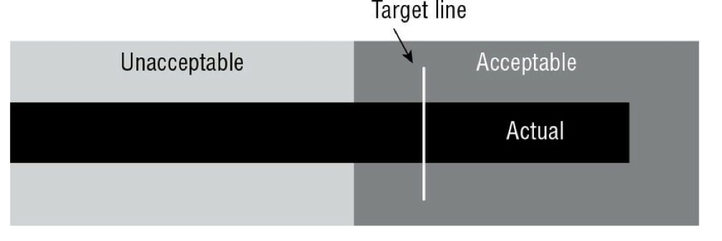
Choosing an Effective Visual
Relative Performance
Story: To help a reader determine whether performance was good, bad, or close to the mark.
Combo Charts & Benchmark Lines
Bullet Graph is relatively new
Notes:
We’ve talked about Story Finding, how cool it is, and the difference between telling and finding. Let’s dive into story telling.

Slide 20
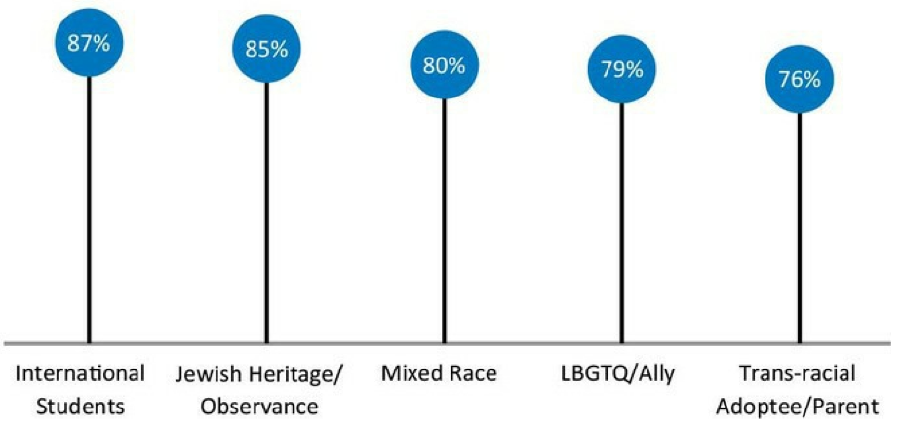
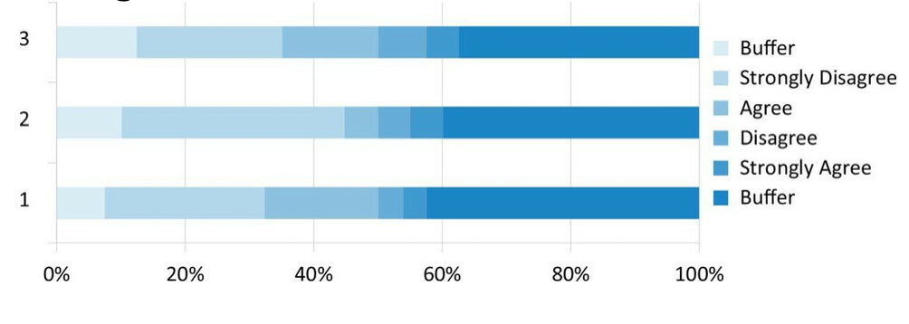
Choosing an Effective Visual
Survey Results
Lollipop Chart
Story: communicate what people think, feel, do, or believe.
Stacked Bar Chart
Notes:
We’ve talked about Story Finding, how cool it is, and the difference between telling and finding. Let’s dive into story telling.

Slide 21
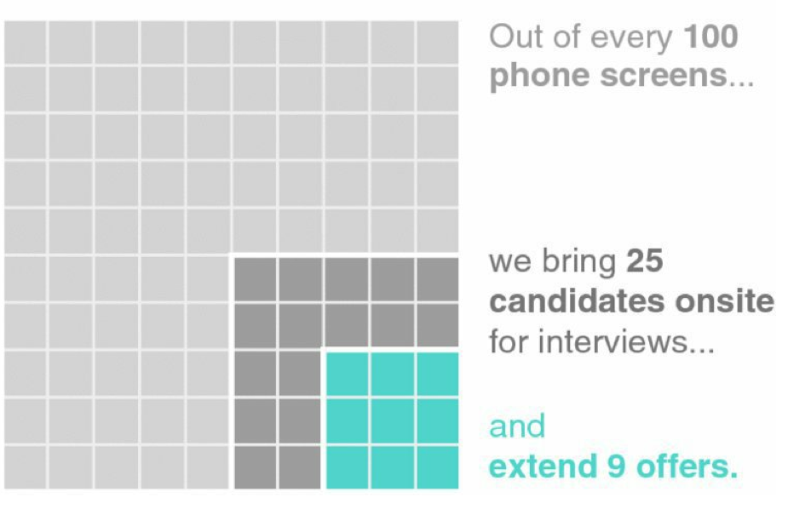
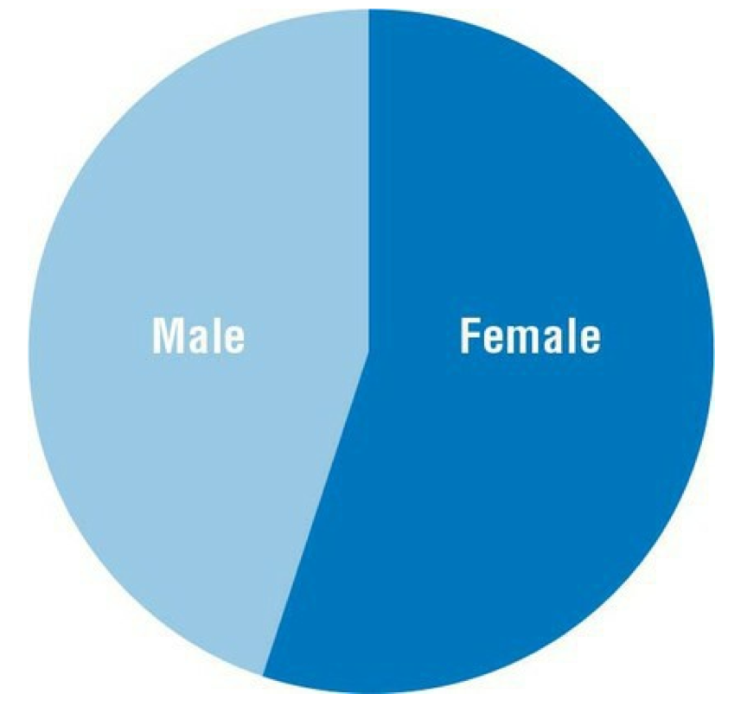
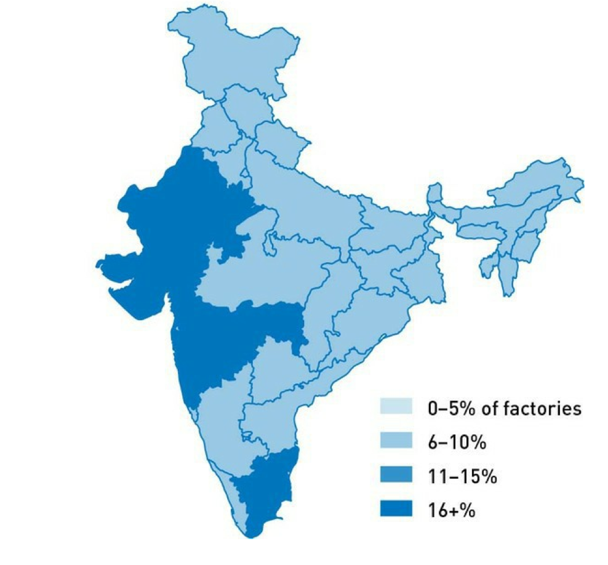
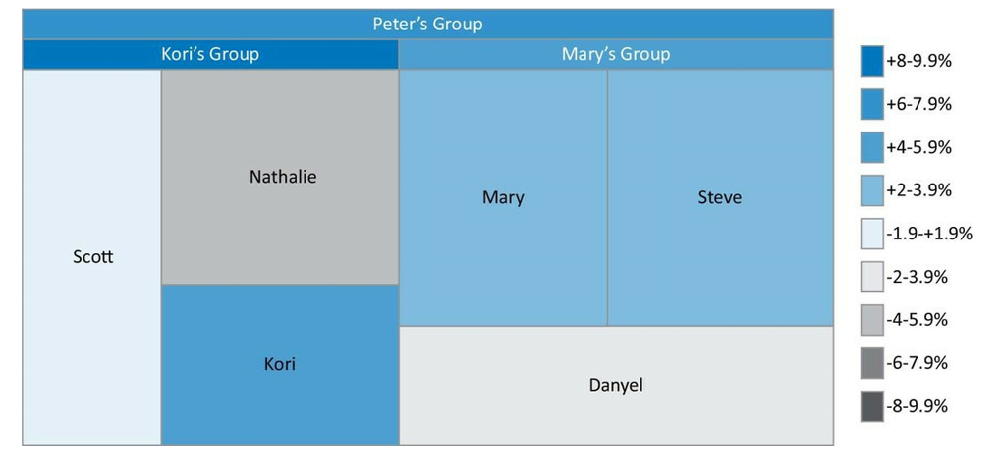
Choosing an Effective Visual
Parts of a Whole
Story: show relationship breakdown, heirarchy, locality
Nested Area Graph
Heat map
Pie Chart
Treemap
Notes:
We’ve talked about Story Finding, how cool it is, and the difference between telling and finding. Let’s dive into story telling.

Slide 22

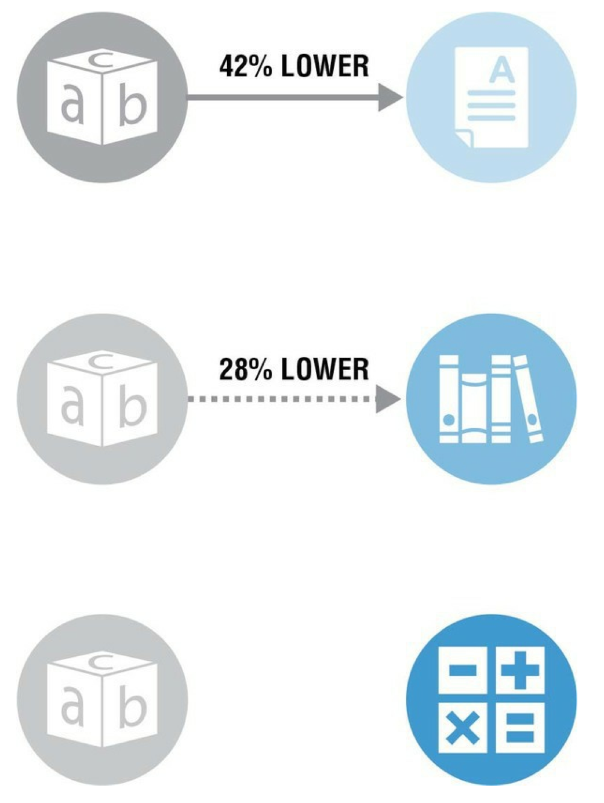
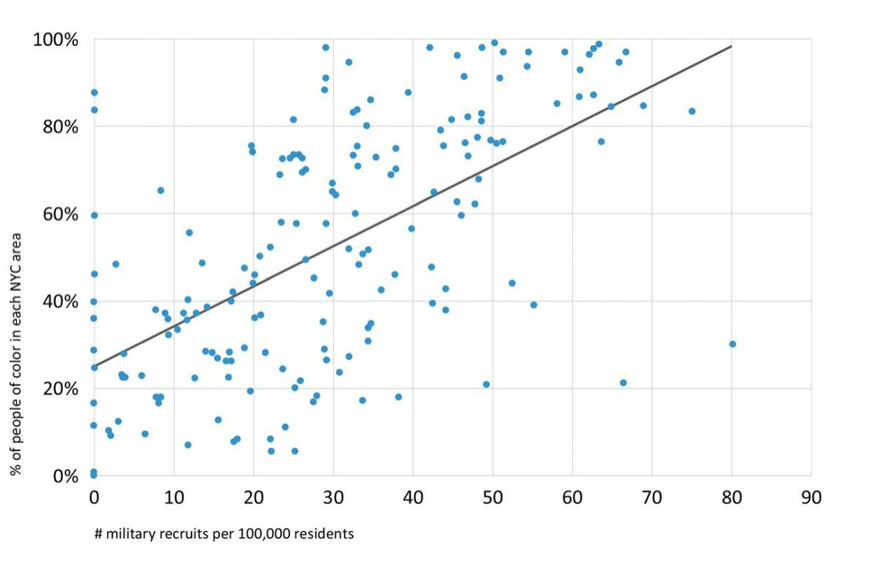
Choosing an Effective Visual
Correlation and Regression
Don’t Visualize
Story: Show relationship with respect to change
Relationship Diagram
Scatter Plot
Use your words
Notes:
We’ve talked about Story Finding, how cool it is, and the difference between telling and finding. Let’s dive into story telling.

Slide 23
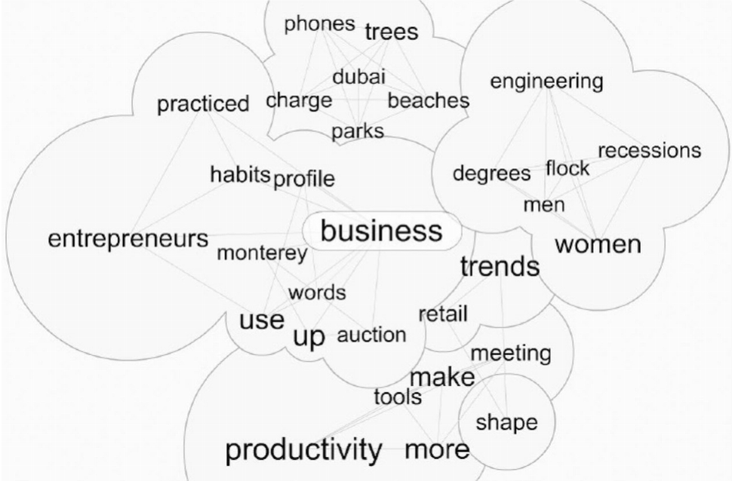
Choosing an Effective Visual
Qualitative Data
Story: To inform by example, to demonstrate your point, prove that it’s believable
Word Cloud
Picture
Notes:
We’ve talked about Story Finding, how cool it is, and the difference between telling and finding. Let’s dive into story telling.

Slide 24
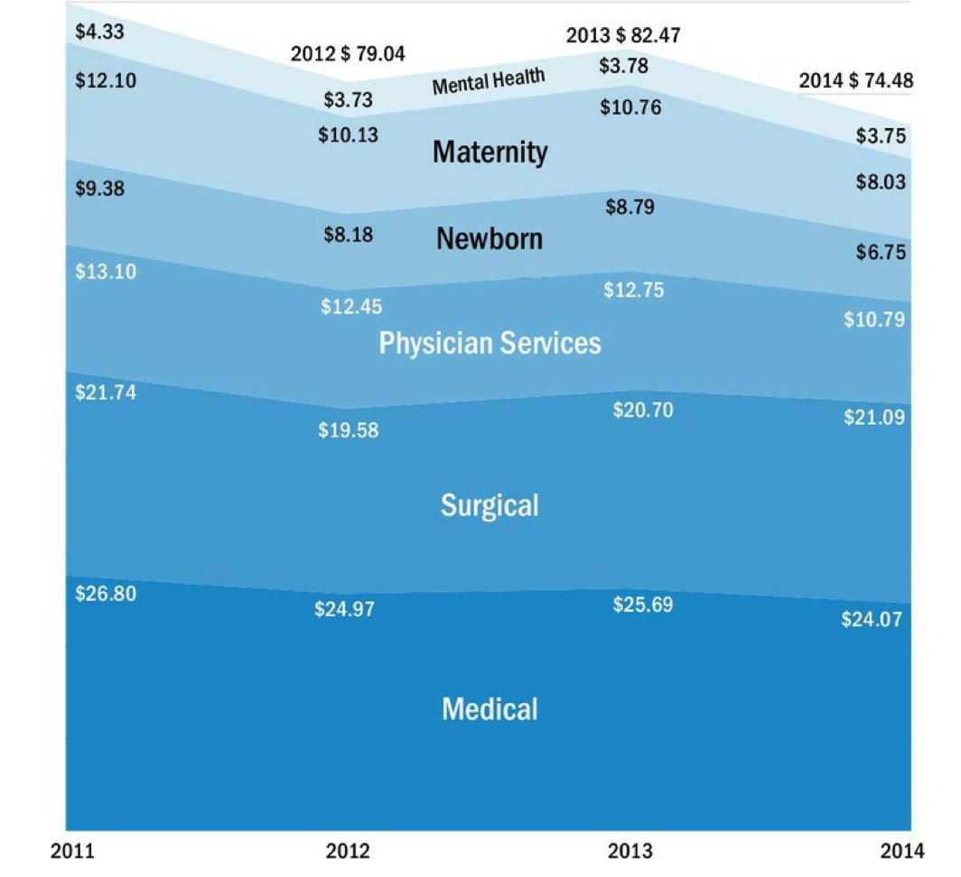
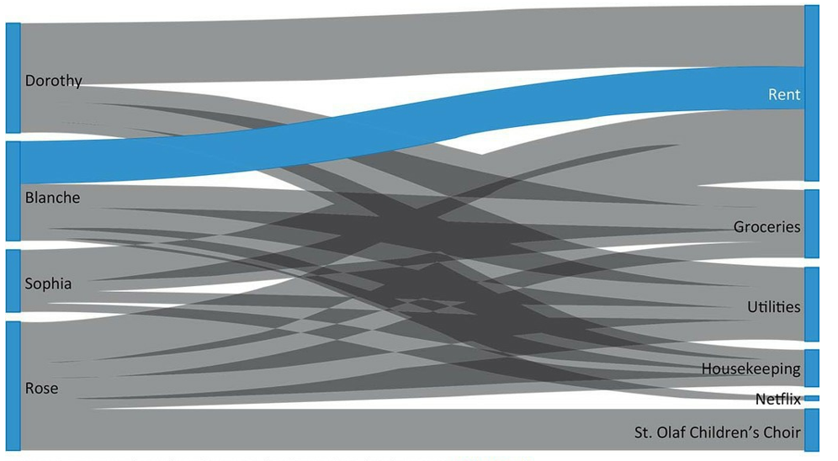
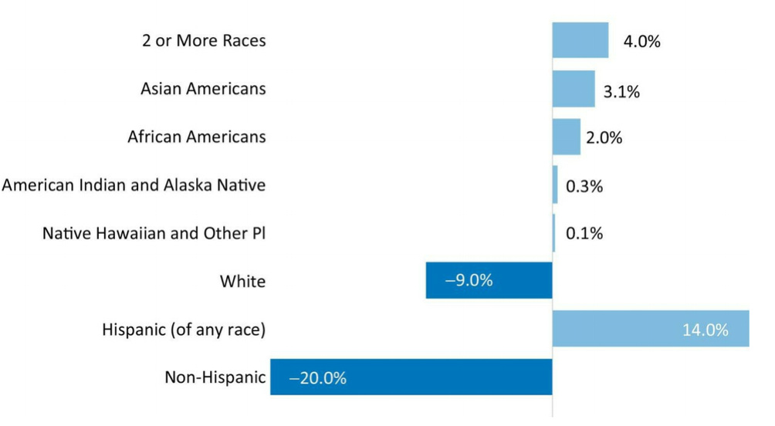
Choosing an Effective Visual
Depicting Trends
lines, bars, slopes etc..
Story: To point out the unknown
Area Graph
Sankey Diagram
Deviation Bar Chart
Notes:
We’ve talked about Story Finding, how cool it is, and the difference between telling and finding. Let’s dive into story telling.

Slide 25


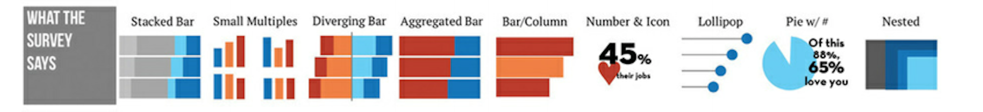
Choosing an Effective Visual
chart chooser cheatsheet
No catch-all visual
Notes:
set this as background?
There’s likely no single visualization that is best. Here are a few and how they are best tied to a story.

Slide 26
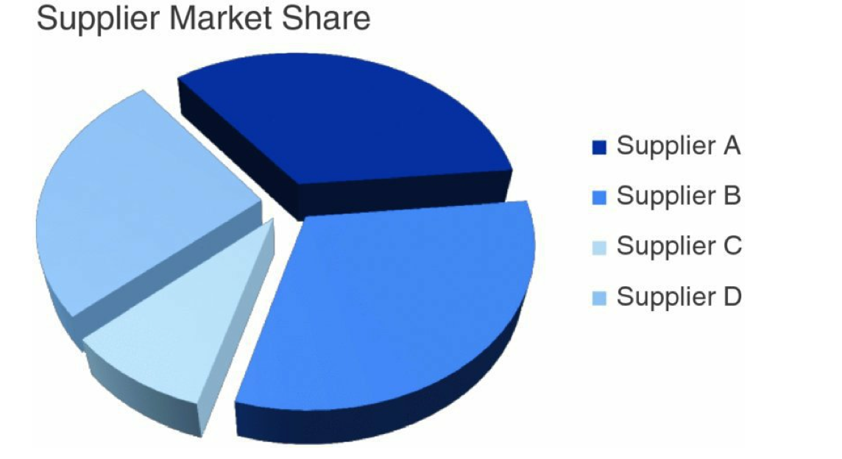
Choosing an Effective Visual
Things to Avoid
Which Supplier has the greatest share of the market?
Notes:
We’ve talked about Story Finding, how cool it is, and the difference between telling and finding. Let’s dive into story telling.

Slide 27
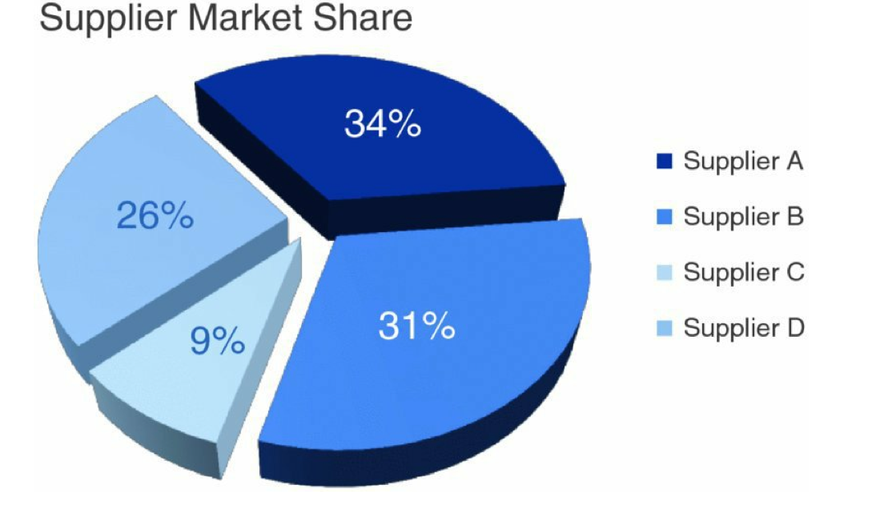
Choosing an Effective Visual
Humans have limitations
Avoid
3D
Pie Charts
Donuts
Double Axis Charts
Issues
Volume
Area
Length & Curvature
Clutter
Notes:
We’ve talked about Story Finding, how cool it is, and the difference between telling and finding. Let’s dive into story telling.

Slide 28
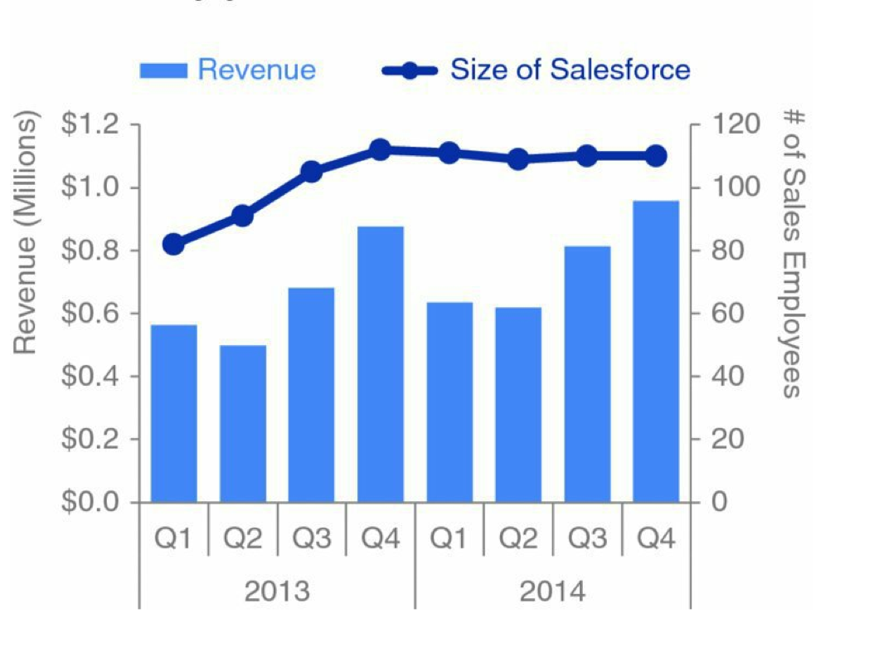
Choosing an Effective Visual
The Storytelling Process
Hard to read vertical text
Hard to tell which axis means what
Notes:
We’ve talked about Story Finding, how cool it is, and the difference between telling and finding. Let’s dive into story telling.

Slide 29
Clutter is your enemy
The Storytelling Process
Cognitive Load (later)
Gestalt Principles of Visual Perception
proximity
similarity
enclosure
closure
continuity
connection
Step by Step guide of removing clutter
Notes:
We’ve talked about Story Finding, how cool it is, and the difference between telling and finding. Let’s dive into story telling.

Slide 30


Clutter is your enemy
Proximity
Notes:
We’ve talked about Story Finding, how cool it is, and the difference between telling and finding. Let’s dive into story telling.

Slide 31
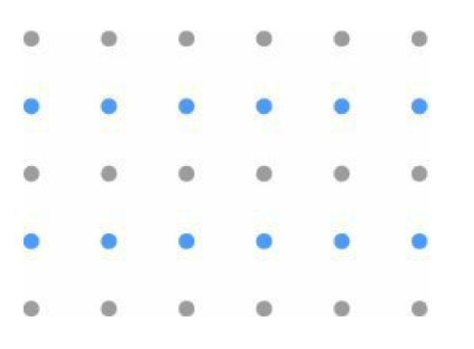
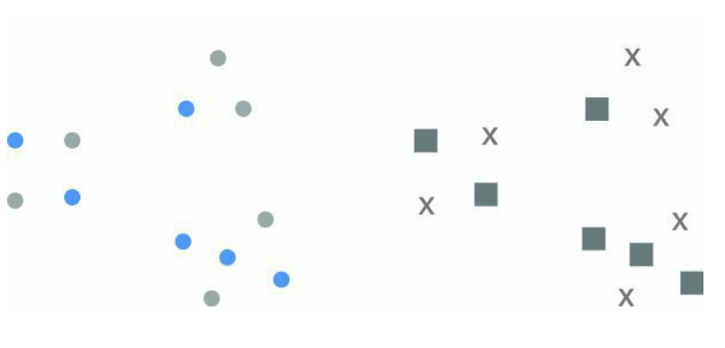
Clutter is your enemy
Similarity
Notes:
We’ve talked about Story Finding, how cool it is, and the difference between telling and finding. Let’s dive into story telling.

Slide 32
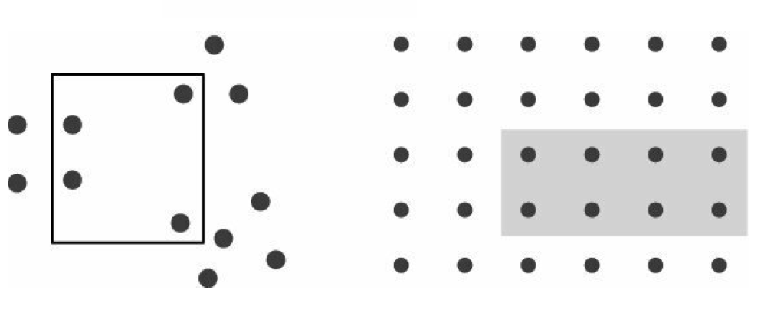
Clutter is your enemy
Enclosure
Notes:
We’ve talked about Story Finding, how cool it is, and the difference between telling and finding. Let’s dive into story telling.

Slide 33

Clutter is your enemy
Closure
Notes:
We’ve talked about Story Finding, how cool it is, and the difference between telling and finding. Let’s dive into story telling.

Slide 34
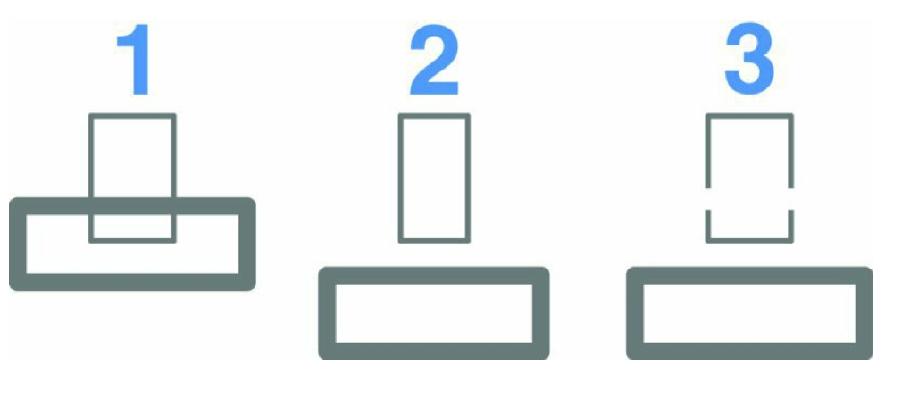
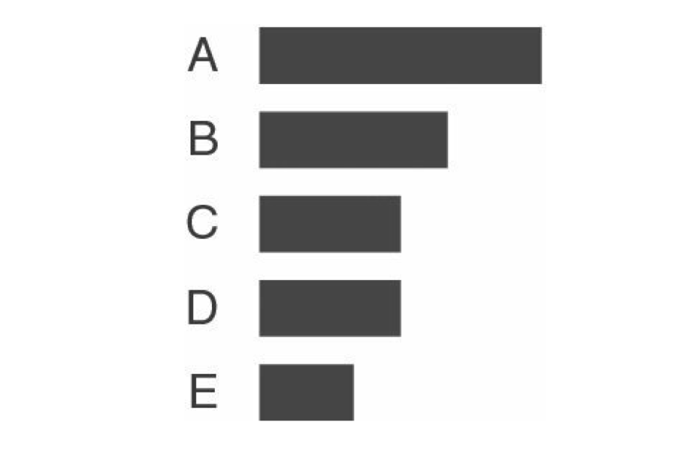
Clutter is your enemy
Continuity
Notes:
We’ve talked about Story Finding, how cool it is, and the difference between telling and finding. Let’s dive into story telling.

Slide 35
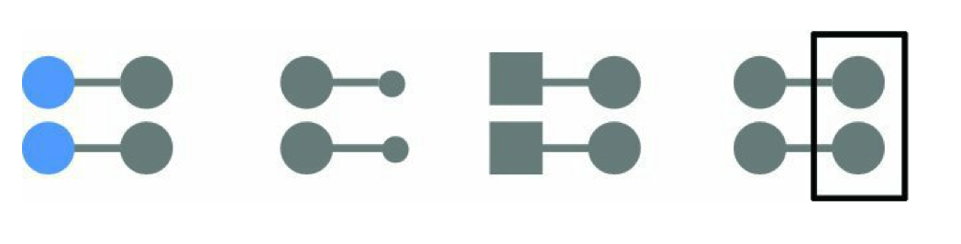
Clutter is your enemy
Connection
Very strong principal. Even trumps others
Notes:
We’ve talked about Story Finding, how cool it is, and the difference between telling and finding. Let’s dive into story telling.

Slide 36
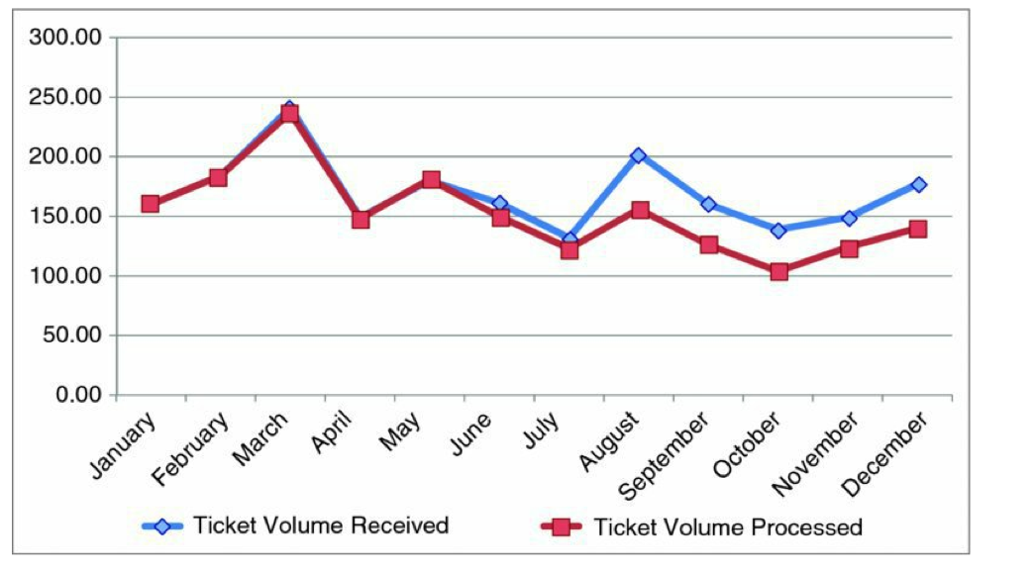
Clutter is your enemy
Step by Step Removal
Original Graph
Notes:
We’ve talked about Story Finding, how cool it is, and the difference between telling and finding. Let’s dive into story telling.

Slide 37
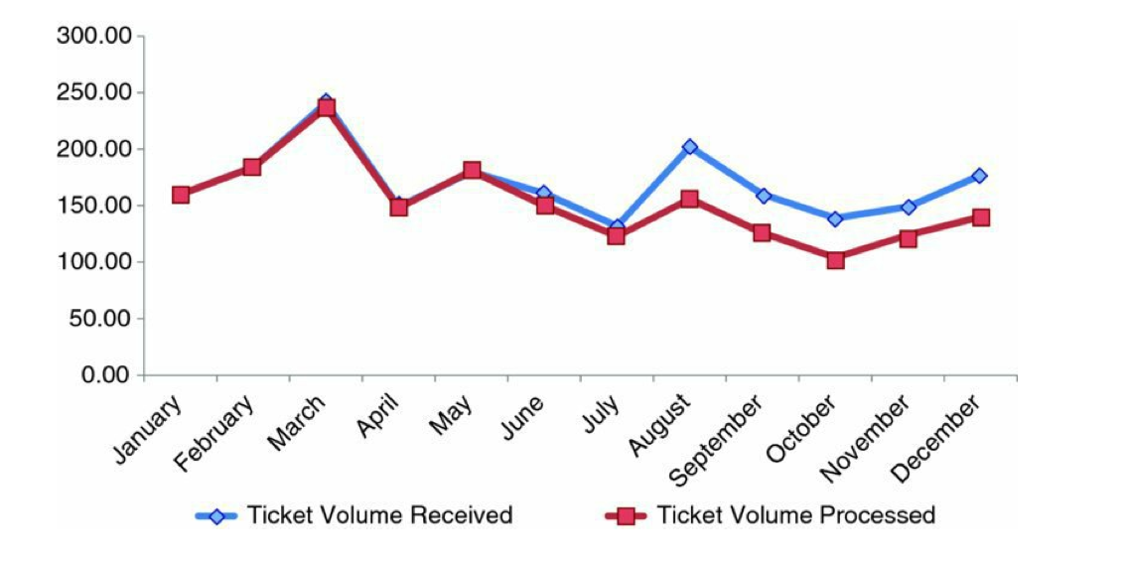
Clutter is your enemy
Remove Chart Borders
Enclosure & Proximity
Notes:
We’ve talked about Story Finding, how cool it is, and the difference between telling and finding. Let’s dive into story telling.

Slide 38
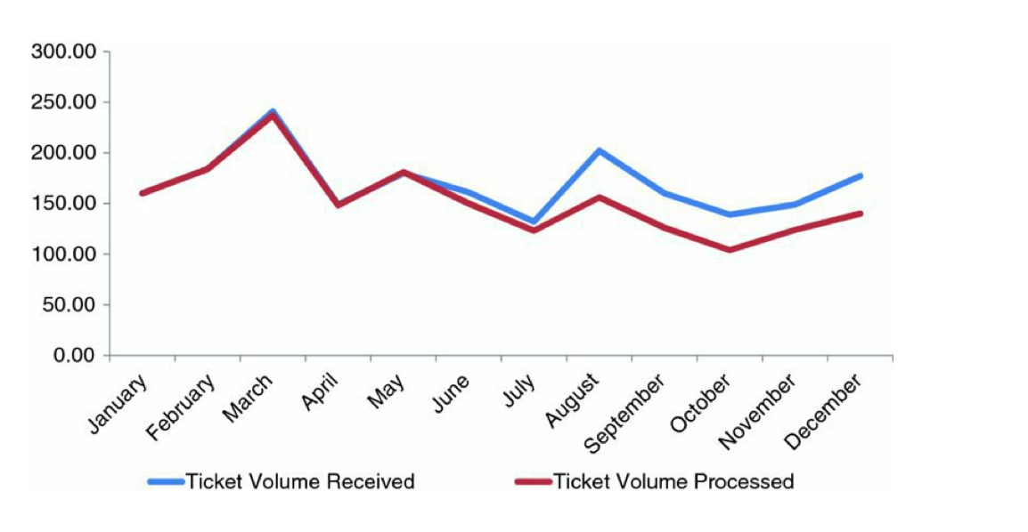
Clutter is your enemy
Remove Data Markers
Continuity
Notes:
We’ve talked about Story Finding, how cool it is, and the difference between telling and finding. Let’s dive into story telling.

Slide 39
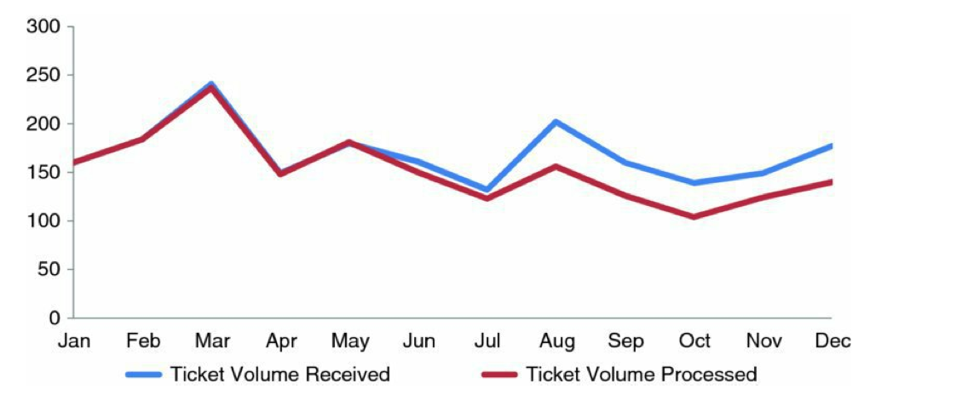
Clutter is your enemy
Clean up Axis Labels
Continuity
Notes:
We’ve talked about Story Finding, how cool it is, and the difference between telling and finding. Let’s dive into story telling.

Slide 40
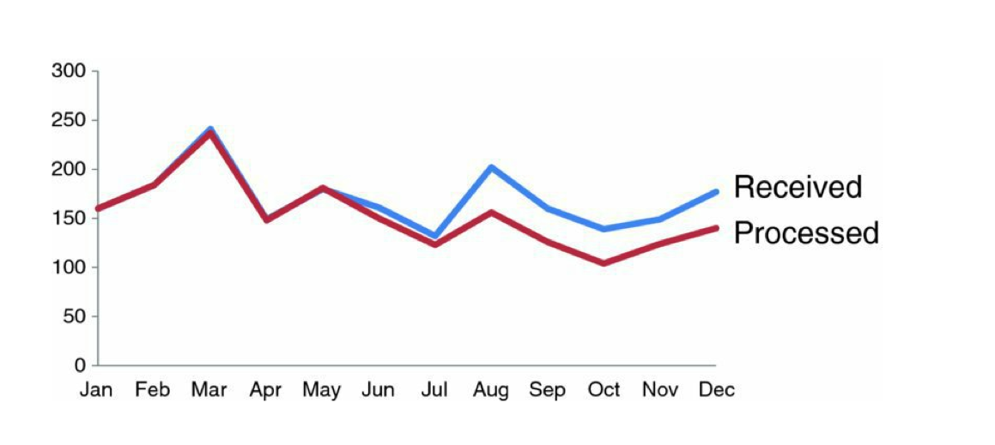

Clutter is your enemy
Label Data Directly
Proximity
Filed
Completed
Notes:
We’ve talked about Story Finding, how cool it is, and the difference between telling and finding. Let’s dive into story telling.

Slide 41
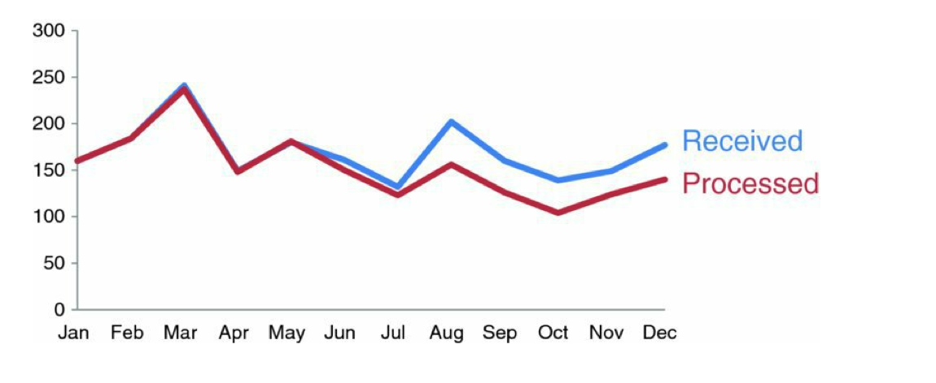
Clutter is your enemy
Leverage Consistent Color
Similarity
Filed
Completed
Notes:
We’ve talked about Story Finding, how cool it is, and the difference between telling and finding. Let’s dive into story telling.

Slide 42
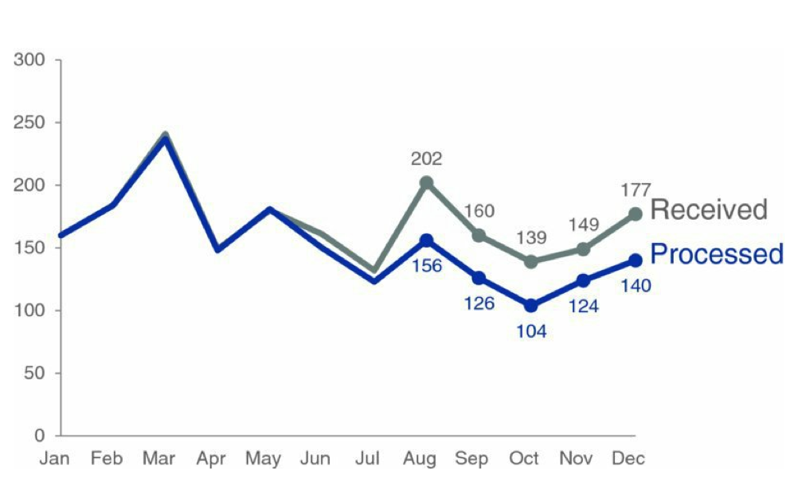
Taking it further
Direct the attention
Filed
Completed
Notes:
We’ve talked about Story Finding, how cool it is, and the difference between telling and finding. Let’s dive into story telling.

Slide 43
Taking it further
Tell the story
The Number of Completed Jira Tickets for the Ahrens Dev Team falls below creation rate for last 7 months.
Filed
Completed
Notes:
We’ve talked about Story Finding, how cool it is, and the difference between telling and finding. Let’s dive into story telling.

Slide 44
Taking it further
Make a suggestion
The Number of Completed Jira Tickets for the Ahrens Dev Team falls below creation rate for last 7 months. Should we investigate? Ping Pong Robot?
Filed
Completed
Notes:
We’ve talked about Story Finding, how cool it is, and the difference between telling and finding. Let’s dive into story telling.

Slide 45
Focus your Audience’s Attention
The Storytelling Process
If we understand how people see we can
Lighten Cognitive Load
Direct Attention
A note on Preattentive Attributes
Notes:
We’ve talked about Story Finding, how cool it is, and the difference between telling and finding. Let’s dive into story telling.

Slide 46
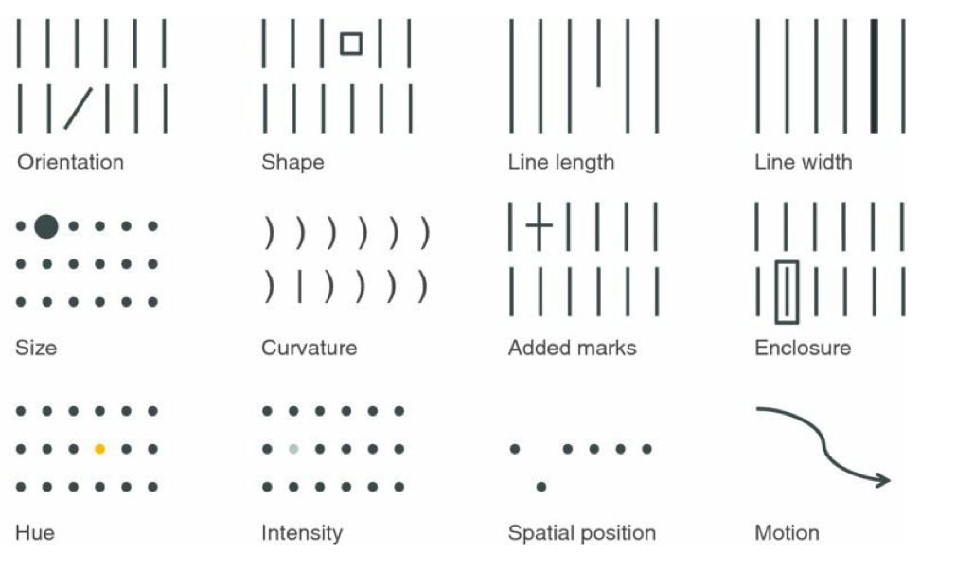
Focus your Audience’s Attention
Before Focusing
Preattentive Attributes
Notes:
We’ve talked about Story Finding, how cool it is, and the difference between telling and finding. Let’s dive into story telling.

Slide 47
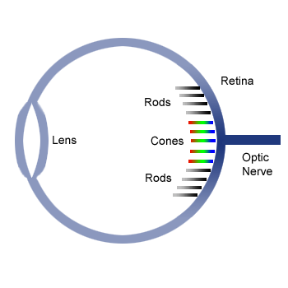
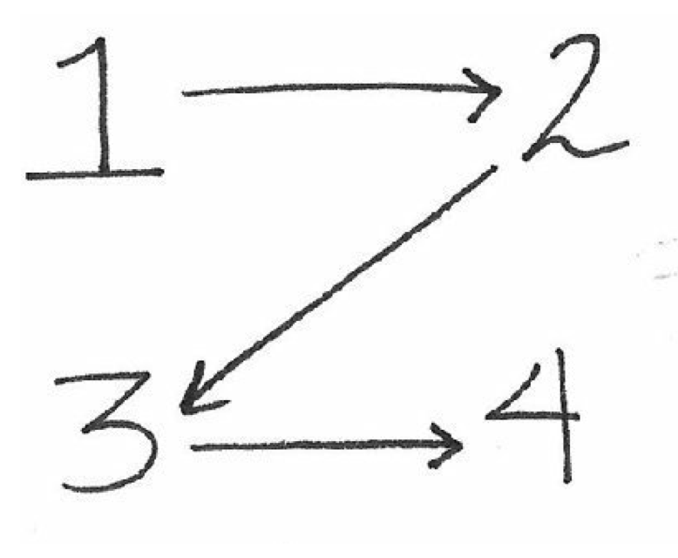

Focus Your Audience’s Attention
Cognitive Load
Path of our eyes
More rods than cones
Avoid combining reds and blues
Notes:
We’ve talked about Story Finding, how cool it is, and the difference between telling and finding. Let’s dive into story telling.

Slide 48

Think like a Designer
Affordance
What should I do with this?
sit!
Important for Interactive Visualizations
Notes:
We’ve talked about Story Finding, how cool it is, and the difference between telling and finding. Let’s dive into story telling.

Slide 49
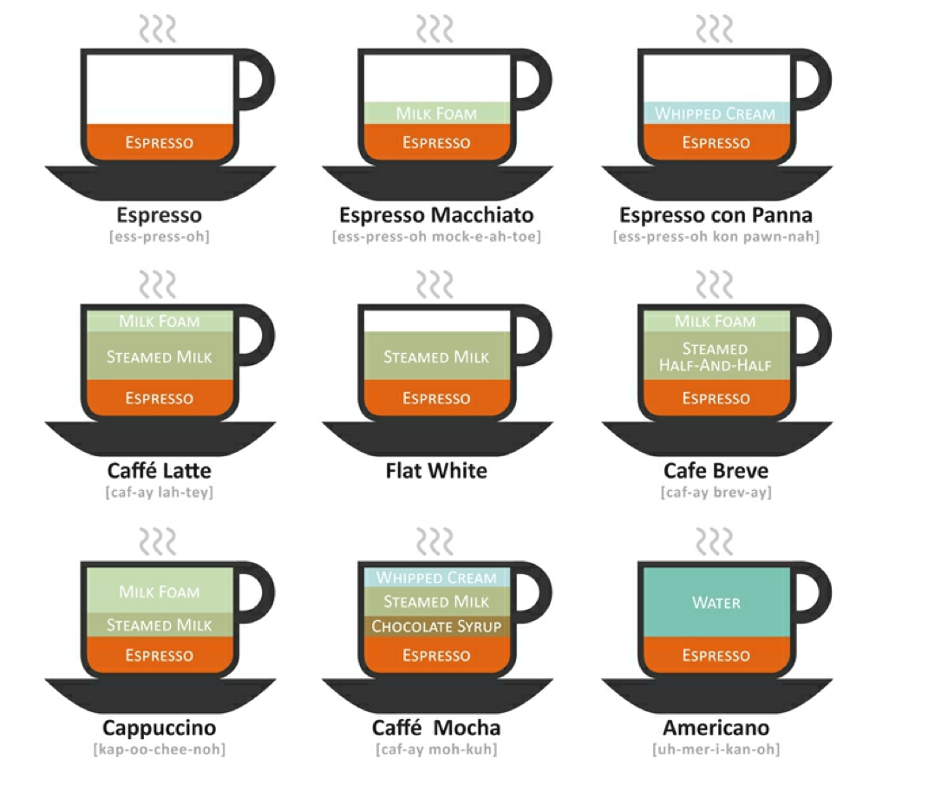

Think like a Designer
Add Visual Context
Just a stacked bar chart
Notes:
We’ve talked about Story Finding, how cool it is, and the difference between telling and finding. Let’s dive into story telling.

Slide 50
Specific Examples
Charts with Dark backgrounds
Apply Storytelling to animated charts
Notes:
We’ve talked about Story Finding, how cool it is, and the difference between telling and finding. Let’s dive into story telling.

Slide 51

Specific Examples
Dark Backgrounds?
Notes:
We’ve talked about Story Finding, how cool it is, and the difference between telling and finding. Let’s dive into story telling.

Slide 52






Specific Examples
Animated Charts
Tableau Style
Notes:
tableu

Slide 53
THANK YOU
Notes:
We’ve talked about Story Finding, how cool it is, and the difference between telling and finding. Let’s dive into story telling.

Slide 54
References
Effective Data Visualization ~ The right chart for the Right Data
Dr. Stephanie D. H. Evergreen
Data Points ~ Visualization that means something
Nathan Yau writer for FlowingData.com. PhD in statistics from UCLA
Storytelling with Data ~ a data visualization guide for business professionals
Cole Nussbaumer Knaflic, Google People/HR Analytics team
Other Recommended Data visualization books
http://flowingdata.com/books/

Slide 55
Questions?
Notes:
We’ve talked about Story Finding, how cool it is, and the difference between telling and finding. Let’s dive into story telling.

